Slide 1


http://www.comp.nus.edu.sg/~cs2100/
Recitation-12
Cache
14 April 2025
Aaron Tan

Slide 2
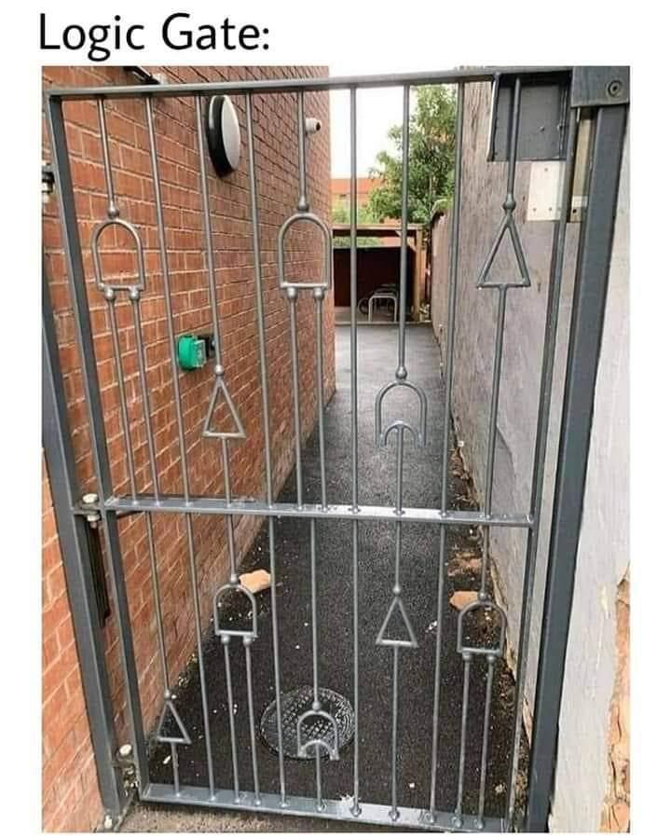

Slide 3
Contents
Cache Revision
Past year’s exam question
AY2021/22 Sem1 Q16
Cache Quiz
Final Exam

Slide 4
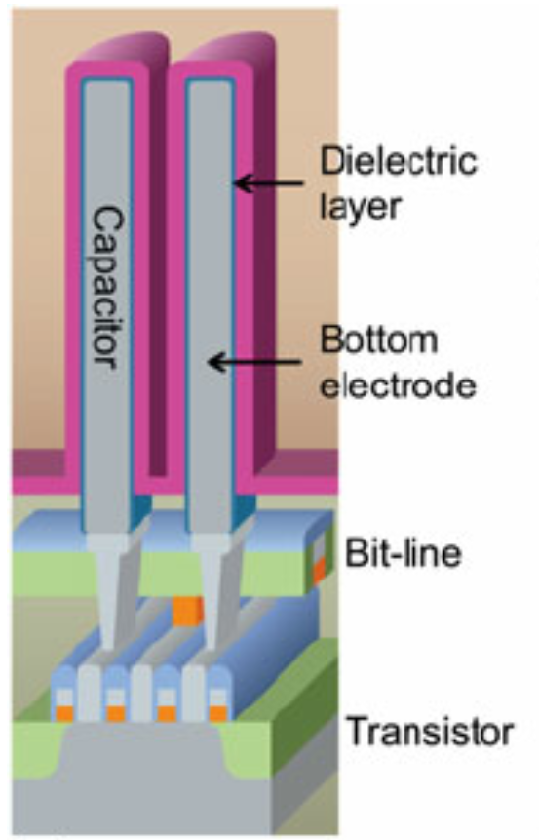
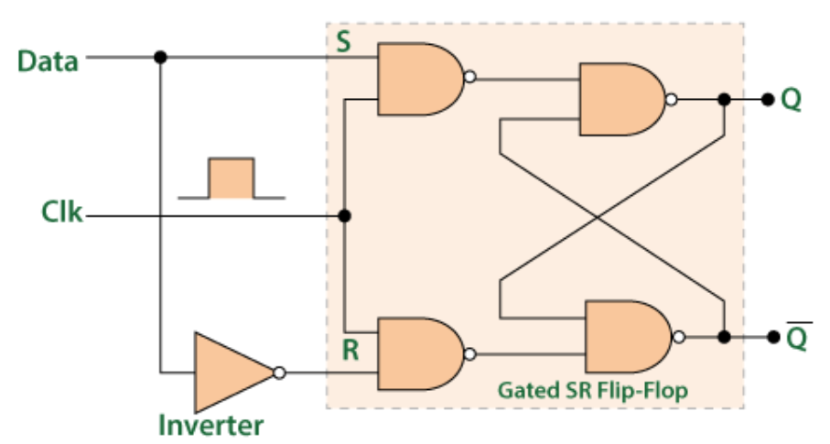
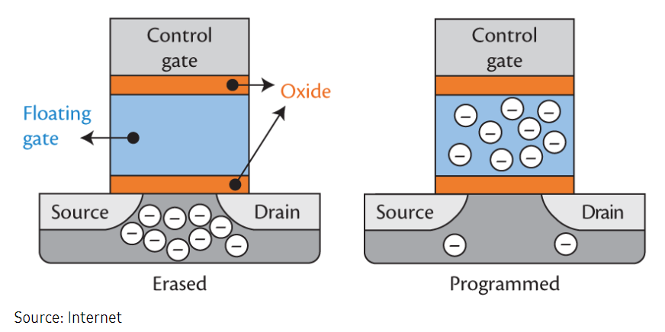
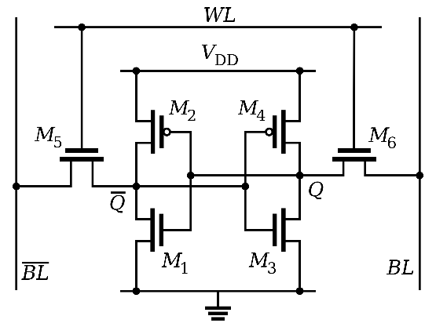
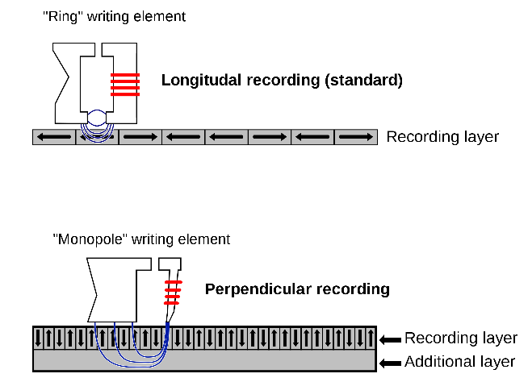
Memory Hierarchy
Cache: 10 to 100 times faster than RAM.
CPU
Registers
Dynamic Random Access Memory
Caches
Source: https://www.researchgate.net/figure/Schematic-diagrams-of-a-DRAM-cells-which-consist-of-a-cell-transistor-and-capacitor_fig1_258797946
D flip-flops
Source: Wikipedia
Higher capacity
Main
Memory
Faster
Flash memory
Long-time
Nonvolatile
Storage
Static Random Access Memory
Magnetic hard disk
Source: Wikipedia
Source: Wikipedia

Slide 5
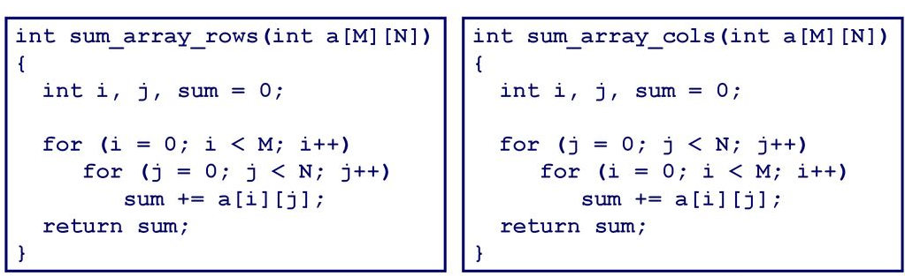
Temporal & Spatial Locality
Example: 4-byte words, 4-word cache blocks.
3×4 integer array A
A[0][0] | A[0][1] | A[0][2] | A[0][3]
A[1][0] | A[1][1] | A[1][2] | A[1][3]
A[2][0] | A[2][1] | A[2][2] | A[2][3]

Slide 6
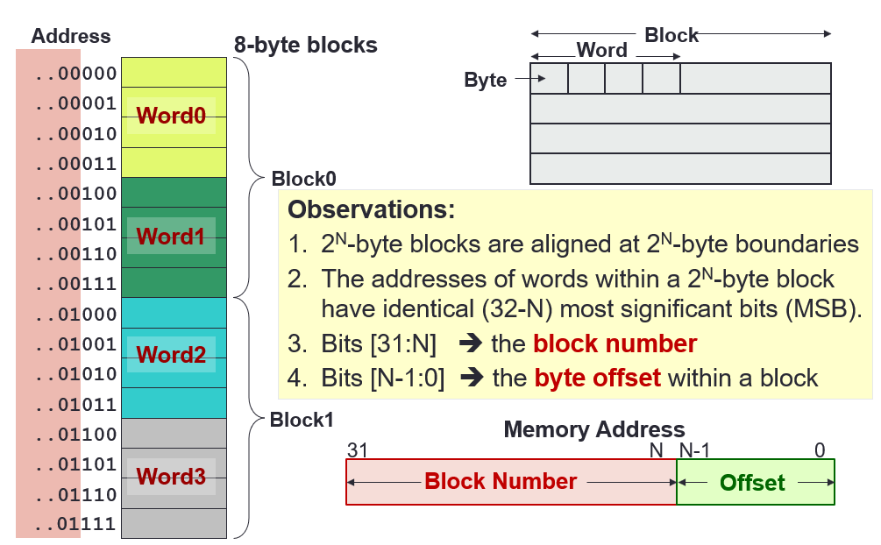
Direct Mapped Cache - Basics
Cache blocks/Line
Block Size
Block Number
Offset
Cache Index
Tag
Block no.
Byte Offset

Slide 7
Direct Mapped Cache - Basics
Cache blocks/Line
Block Size
Block Number
Offset
Cache Index
Tag
Block Number (Not Address!)
Cache Index
..00000
One block
One block
00
Index
..00001
01
..00010
10
..00011
Mapping Function:
Cache Index
= (BlockNumber) modulo
(NumberOfCacheBlocks)
11
..00100
Cache
..00101
..00110
Memory
..00111
..01000
Observation:
If Number of Cache Blocks = 2^{M}
➔ the last M bits of the block number is the cache index
Example:
Cache has 2² = 4 blocks
➔ last 2 bits of the block number is the cache index.
..01001
..01010
..01011
..01100
..01101
..01110
..01111

Slide 8
Direct Mapped Cache - Basics
Cache blocks/Line
Block Size
Block Number
Offset
Cache Index
Tag
Block Number (Not Address!)
Cache Index
..00000
One block
One block
00
..00001
01
Tag
..00010
10
..00011
Mapping Function:
Cache Index
= (BlockNumber) modulo
(NumberOfCacheBlocks)
11
..00100
Cache
..00101
..00110
Memory
..00111
..01000
Observation:
Multiple memory blocks can map to the same cache block
➔ Same Cache Index
However, they have unique tag number:
Tag = Block number / Number of Cache Blocks
..01001
..01010
..01011
..01100
..01101
..01110
..01111

Slide 9
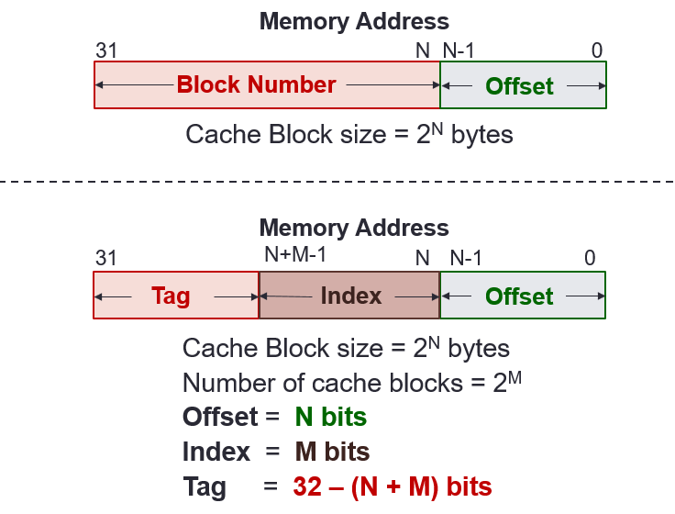
Direct Mapped Cache - Basics
Memory address
Tag
Index
Byte Offset

Slide 10
Direct Mapped Cache - Basics
Valid
Tag
Data
Index
Cache
00
01
10
11
Along with a data block (line), cache also contains the following administrative information (overheads):
Tag of the memory block
Valid bit indicating whether the cache line contains valid data
When is there a cache hit?
( Valid[index] = TRUE ) AND ( Tag[ index ] = Tag[ memory address ] )

Slide 11
Direct Mapped Cache - Example
Memory Address
Memory
4GB
31
N
N-1
0
Block Number
Offset
Offset, N = 4 bits
Block Number = 32 – 4 = 28 bits
Check: Number of Blocks = 2²⁸
1 Block
= 16 bytes
31
N+M-1
N
N-1
0
Cache
16KB
Tag
Index
Offset
Number of Cache Blocks
= 16KB / 16bytes = 1024 = 2¹⁰
Cache Index, M = 10bits
Cache Tag = 32 – 10 – 4 = 18 bits
1 Block
= 16 bytes

Slide 12
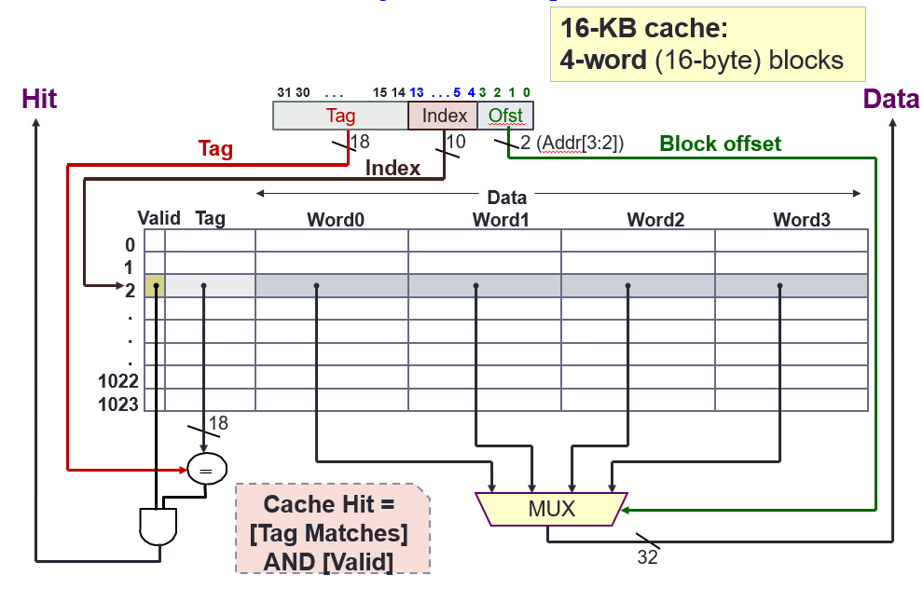
Direct Mapped Cache - Example

Slide 13
5. Reading Data: Setup
Direct Mapped Cache
Given a direct mapped 16KB cache:
16-byte blocks x 1024 cache blocks
Trace the following memory accesses:
Tag
Index
Offset
31
14
13
4
3
0
000000000000000000
0000000001
0100
000000000000000000
0000000001
1100
000000000000000000
0000000011
0100
000000000000000010
0000000001
1000
000000000000000000
0000000001
0000

Slide 14
5. Reading Data: Initial State
Direct Mapped Cache
Intially cache is empty
➔ All valid bits are zeroes (false)
Data
Word0
Word1
Word2
Word3
Index
Valid
Tag
Bytes 0-3
Bytes 4-7
Bytes 8-11
Bytes 12-15
0
0
1
0
2
0
3
0
4
0
5
0
... ... ... … … … … …
1022
0
1023
0

Slide 15
5. Reading Data: Load #1-1
Tag
Index
Offset
Load from
Step 1. Check Cache Block at index 1
000000000000000000
0000000001
0100
Data
Word0
Word1
Word2
Word3
Index
Valid
Tag
Bytes 0-3
Bytes 4-7
Bytes 8-11
Bytes 12-15
0
0
1
0
2
0
3
0
4
0
5
0
... ... ... … … … … …
1022
0
1023
0

Slide 16
5. Reading Data: Load #1-2
Direct Mapped Cache
Tag
Index
Offset
Load from
Step 2. Data in block 1 is invalid [Cold/Compulsory Miss]
000000000000000000
0000000001
0100
Data
Word0
Word1
Word2
Word3
Index
Valid
Tag
Bytes 0-3
Bytes 4-7
Bytes 8-11
Bytes 12-15
0
0
1
0
2
0
3
0
4
0
5
0
... ... ... … … … … …
1022
0
1023
0

Slide 17
5. Reading Data: Load #1-3
Direct Mapped Cache
Tag
Index
Offset
Load from
Step 3. Load 16 bytes from memory; Set Tag and Valid bit
000000000000000000
0000000001
0100
Data
Word0
Word1
Word2
Word3
Index
Valid
Tag
Bytes 0-3
Bytes 4-7
Bytes 8-11
Bytes 12-15
0
0
1
1
0
A
B
C
D
2
0
3
0
4
0
5
0
... ... ... … … … … …
1022
0
1023
0

Slide 18
5. Reading Data: Load #1-4
Direct Mapped Cache
Tag
Index
Offset
Load from
Step 4. Return Word1 (byte offset = 4) to Register
000000000000000000
0000000001
0100
Data
Word0
Word1
Word2
Word3
Index
Valid
Tag
Bytes 0-3
Bytes 4-7
Bytes 8-11
Bytes 12-15
0
0
1
1
0
A
B
C
D
2
0
3
0
4
0
5
0
... ... ... … … … … …
1022
0
1023
0

Slide 19
5. Reading Data: Load #2-1
Direct Mapped Cache
Tag
Index
Offset
Load from
Step 1. Check Cache Block at index 1
000000000000000000
0000000001
1100
Data
Word0
Word1
Word2
Word3
Index
Valid
Tag
Bytes 0-3
Bytes 4-7
Bytes 8-11
Bytes 12-15
0
0
1
1
0
A
B
C
D
2
0
3
0
4
0
5
0
... ... ... … … … … …
1022
0
1023
0

Slide 20
5. Reading Data: Load #2-2
Direct Mapped Cache
Tag
Index
Offset
Load from
Step 2. [Cache Block is Valid] AND [Tags match] ➔ Cache hit!
000000000000000000
0000000001
1100
Data
Word0
Word1
Word2
Word3
Index
Valid
Tag
Bytes 0-3
Bytes 4-7
Bytes 8-11
Bytes 12-15
0
0
1
1
0
A
B
C
D
2
0
3
0
4
0
5
0
... ... ... … … … … …
1022
0
1023
0

Slide 21
5. Reading Data: Load #2-3
Tag
Index
Offset
Load from
Step 3. Return Word3 (byte offset = 12) to Register [Spatial Locality]
000000000000000000
0000000001
1100
Data
Word0
Word1
Word2
Word3
Index
Valid
Tag
Bytes 0-3
Bytes 4-7
Bytes 8-11
Bytes 12-15
0
0
1
1
0
A
B
C
D
2
0
3
0
4
0
5
0
... ... ... … … … … …
1022
0
1023
0

Slide 22
5. Reading Data: Load #3-1
Direct Mapped Cache
Tag
Index
Offset
Load from
Step 1. Check Cache Block at index 3
000000000000000000
0000000011
0100
Data
Word0
Word1
Word2
Word3
Index
Valid
Tag
Bytes 0-3
Bytes 4-7
Bytes 8-11
Bytes 12-15
0
0
1
1
0
A
B
C
D
2
0
3
0
4
0
5
0
... ... ... … … … … …
1022
0
1023
0

Slide 23
5. Reading Data: Load #3-2
Direct Mapped Cache
Tag
Index
Offset
Load from
Step 2. Data in block 3 is invalid [Cold/Compulsory Miss]
000000000000000000
0000000011
0100
Data
Word0
Word1
Word2
Word3
Index
Valid
Tag
Bytes 0-3
Bytes 4-7
Bytes 8-11
Bytes 12-15
0
0
1
1
0
A
B
C
D
2
0
3
0
4
0
5
0
... ... ... … … … … …
1022
0
1023
0

Slide 24
5. Reading Data: Load #3-3
Direct Mapped Cache
Tag
Index
Offset
Load from
Step 3. Load 16 bytes from memory; Set Tag and Valid bit
000000000000000000
0000000011
0100
Data
Word0
Word1
Word2
Word3
Index
Valid
Tag
Bytes 0-3
Bytes 4-7
Bytes 8-11
Bytes 12-15
0
0
1
1
0
A
B
C
D
2
0
3
1
0
I
J
K
L
4
0
5
0
... ... ... … … … … …
1022
0
1023
0

Slide 25
5. Reading Data: Load #3-4
Direct Mapped Cache
Tag
Index
Offset
Load from
Step 4. Return Word1 (byte offset = 4) to Register
000000000000000000
0000000011
0100
Data
Word0
Word1
Word2
Word3
Index
Valid
Tag
Bytes 0-3
Bytes 4-7
Bytes 8-11
Bytes 12-15
0
0
1
1
0
A
B
C
D
2
0
3
1
0
I
J
K
L
4
0
5
0
... ... ... … … … … …
1022
0
1023
0

Slide 26
5. Reading Data: Load #4-1
Direct Mapped Cache
Tag
Index
Offset
Load from
Step 1. Check Cache Block at index 1
000000000000000010
0000000001
1000
Data
Word0
Word1
Word2
Word3
Index
Valid
Tag
Bytes 0-3
Bytes 4-7
Bytes 8-11
Bytes 12-15
0
0
1
1
0
A
B
C
D
2
0
3
1
0
I
J
K
L
4
0
5
0
... ... ... … … … … …
1022
0
1023
0

Slide 27
5. Reading Data: Load #4-2
Direct Mapped Cache
Tag
Index
Offset
Load from
Step 2. Cache block is Valid but Tags mismatch [Cold miss]
000000000000000010
0000000001
1000
Data
Word0
Word1
Word2
Word3
Index
Valid
Tag
Bytes 0-3
Bytes 4-7
Bytes 8-11
Bytes 12-15
0
0
1
1
0
A
B
C
D
2
0
3
1
0
I
J
K
L
4
0
5
0
... ... ... … … … … …
1022
0
1023
0

Slide 28
5. Reading Data: Load #4-3
Direct Mapped Cache
Tag
Index
Offset
Load from
Step 3. Replace block 1 with new data; Set Tag
000000000000000010
0000000001
1000
Data
Word0
Word1
Word2
Word3
Index
Valid
Tag
Bytes 0-3
Bytes 4-7
Bytes 8-11
Bytes 12-15
0
0
1
1
2
E
F
G
H
2
0
3
1
0
I
J
K
L
4
0
5
0
... ... ... … … … … …
1022
0
1023
0

Slide 29
5. Reading Data: Load #4-4
Direct Mapped Cache
Tag
Index
Offset
Load from
Step 4. Return Word2 (byte offset = 8) to Register
000000000000000010
0000000001
1000
Data
Word0
Word1
Word2
Word3
Index
Valid
Tag
Bytes 0-3
Bytes 4-7
Bytes 8-11
Bytes 12-15
0
0
1
1
2
E
F
G
H
2
0
3
1
0
I
J
K
L
4
0
5
0
... ... ... … … … … …
1022
0
1023
0

Slide 30
5. Reading Data: Load #5-1
Direct Mapped Cache
Tag
Index
Offset
Load from
Step 1. Check Cache Block at index 1
000000000000000000
0000000001
0000
Data
Word0
Word1
Word2
Word3
Index
Valid
Tag
Bytes 0-3
Bytes 4-7
Bytes 8-11
Bytes 12-15
0
0
1
1
2
E
F
G
H
2
0
3
1
0
I
J
K
L
4
0
5
0
... ... ... … … … … …
1022
0
1023
0

Slide 31
5. Reading Data: Load #5-2
Direct Mapped Cache
Tag
Index
Offset
Load from
Step 2. Cache block is Valid but Tags mismatch [Cold miss]
000000000000000000
0000000001
0000
Data
Word0
Word1
Word2
Word3
Index
Valid
Tag
Bytes 0-3
Bytes 4-7
Bytes 8-11
Bytes 12-15
0
0
1
1
2
E
F
G
H
2
0
3
1
0
I
J
K
L
4
0
5
0
... ... ... … … … … …
1022
0
1023
0

Slide 32
5. Reading Data: Load #5-3
Direct Mapped Cache
Tag
Index
Offset
Load from
Step 3. Replace block 1 with new data; Set Tag
000000000000000000
0000000001
0000
Data
Word0
Word1
Word2
Word3
Index
Valid
Tag
Bytes 0-3
Bytes 4-7
Bytes 8-11
Bytes 12-15
0
0
1
1
0
A
B
C
D
2
0
3
1
0
I
J
K
L
4
0
5
0
... ... ... … … … … …
1022
0
1023
0

Slide 33
5. Reading Data: Load #5-4
Direct Mapped Cache
Tag
Index
Offset
Load from
Step 4. Return Word0 (byte offset = 0) to Register
000000000000000000
0000000001
0000
Data
Word0
Word1
Word2
Word3
Index
Valid
Tag
Bytes 0-3
Bytes 4-7
Bytes 8-11
Bytes 12-15
0
0
1
1
0
A
B
C
D
2
0
3
1
0
I
J
K
L
4
0
5
0
... ... ... … … … … …
1022
0
1023
0

Slide 34
3. Set Associative (SA) Cache
N-way Set Associative Cache
A memory block can be placed in a fixed number (N) of locations in the cache, where N > 1
Key Idea:
Cache consists of a number of sets:
Each set contains N cache blocks
Each memory block maps to a unique cache set
Within the set, a memory block can be placed in any of the N cache blocks in the set

Slide 35
3. Set Associative Cache: Structure
Valid
Tag
Data
Valid
Tag
Data
Set Index
00
01
Set
10
11
2-way Set Associative Cache
An example of 2-way set associative cache
Each set has two cache blocks
A memory block maps to a unique set
In the set, the memory block can be placed in either of the cache blocks
➔ Need to search both blocks in the set to look for the memory block

Slide 36
3. Set Associative Cache: Mapping
Memory Address
31
N
N-1
0
Block Number
Offset
Cache Block size = 2^{N} bytes
Cache Set Index
= (BlockNumber) modulo (NumberOfCacheSets)
31
N+M-1
N
N-1
0
Tag
Set Index
Offset
Cache Block size = 2^{N} bytes
Number of cache sets = 2^{M}
Offset = N bits
Set Index = M bits
Tag = 32 – (N + M) bits
Observation:
It is essentially unchanged from the direct-mapping formula

Slide 37
3. Set Associative Cache: Example
Memory Address
Memory
4GB
31
N
N-1
0
Block Number
Offset
Offset, N = 2 bits
Block Number = 32 – 2 = 30 bits
Check: Number of Blocks = 2³⁰
1 Block
= 4 bytes
31
N+M-1
N
N-1
0
Tag
Set Index
Offset
Number of Cache Blocks
= 4KB / 4bytes = 1024 = 2¹⁰
4-way associative, number of sets
= 1024 / 4 = 256 = 2⁸
Set Index, M = 8 bits
Cache Tag = 32 – 8 – 2 = 22 bits
Cache
4 KB

Slide 38
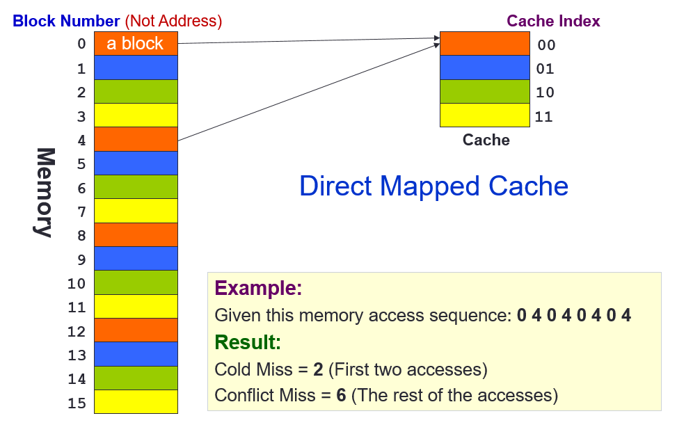
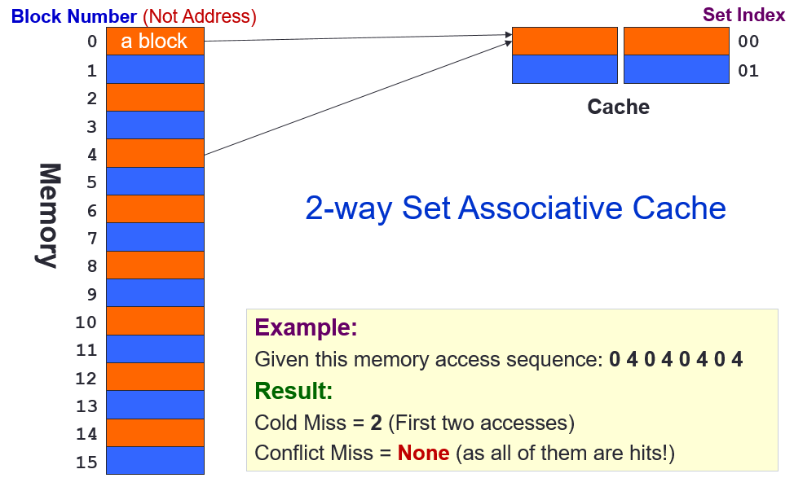
Direct Mapped Cache vs 2-way Set Assoc Cache

Slide 39
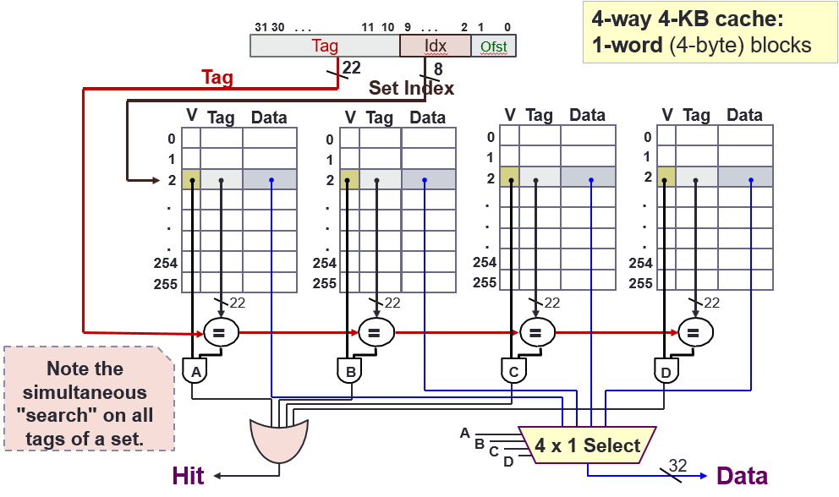
4-way Set Associative Cache

Slide 40
4. Fully Associative (FA) Cache
Fully Associative Cache
A memory block can be placed in any location in the cache
Key Idea:
Memory block placement is no longer restricted by cache index or cache set index
++ Can be placed in any location, BUT
--- Need to search all cache blocks for memory access

Slide 41
4. Fully Associative Cache: Mapping
Memory Address
31
N
N-1
0
Block Number
Offset
Cache Block size = 2^{N} bytes
31
N
N-1
0
Tag
Offset
Cache Block size = 2^{N} bytes
Number of cache blocks = 2^{M}
Offset = N bits
Tag = 32 – N bits
Observation:
The block number serves as the tag in FA cache.

Slide 42
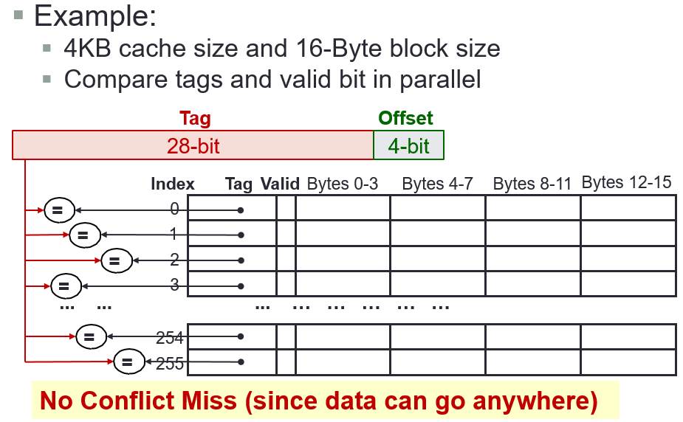
Fully Associative Cache

Slide 43
5. Block Replacement Policy (1/3)
Set Associative or Fully Associative Cache:
Can choose where to place a memory block
Potentially replacing another cache block if full
Need block replacement policy
Least Recently Used (LRU)
How: For cache hit, record the cache block that was accessed
When replacing a block, choose one which has not been accessed for the longest time
Why: Temporal locality

Slide 44
5. Block Replacement Policy (2/3)
Least Recently Used policy in action:
4-way SA cache
Memory accesses: 0 4 8 12 4 16 12 0 4
LRU
Access 4
0
4
8
12
Hit
Access 16
0
8
12
4
Miss (Evict Block 0)
x
Access 12
8
12
4
16
Hit
Access 0
8
4
16
12
Miss (Evict Block 8)
x
Access 4
4
16
12
0
Hit
16
12
0
4

Slide 45
5. Block Replacement Policy (3/3)
Drawback for LRU
Hard to keep track if there are many choices
Other replacement policies:
First in first out (FIFO)
Random replacement (RR)
Least frequently used (LFU)

Slide 46
Types of Cache Misses
Compulsory misses
On the first access to a block; the block must be brought into the cache
Also called cold start misses or first reference misses
Conflict misses
Occur in the case of direct mapped cache or set associative cache, when several blocks are mapped to the same block/set
Also called collision misses or interference misses
Capacity misses
Occur when blocks are discarded from cache as cache cannot contain all blocks needed

Slide 47
Handling Misses
On a Read Miss:
Data loaded into cache and then load from there to register
Write Miss option 1: Write allocate
Load the complete block into cache
Change only the required word in cache
Write to main memory depends on write policy (write-through or write-back)
Write Miss option 2: Write around
Do not load the block to cache
Write directly to main memory only

Slide 48
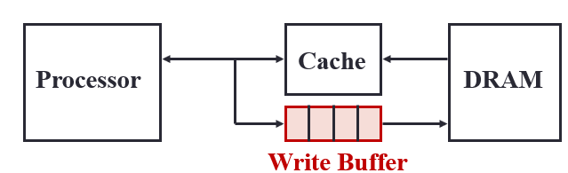
Write Policy in Cache
Cache and main memory are inconsistent
Modified data only in cache, not in memory!
Solution 1: Write-through cache
Write data both to cache and to main memory
Solution 2: Write-back cache
Only write to cache
Write to main memory only when cache block is replaced (evicted)

Slide 49
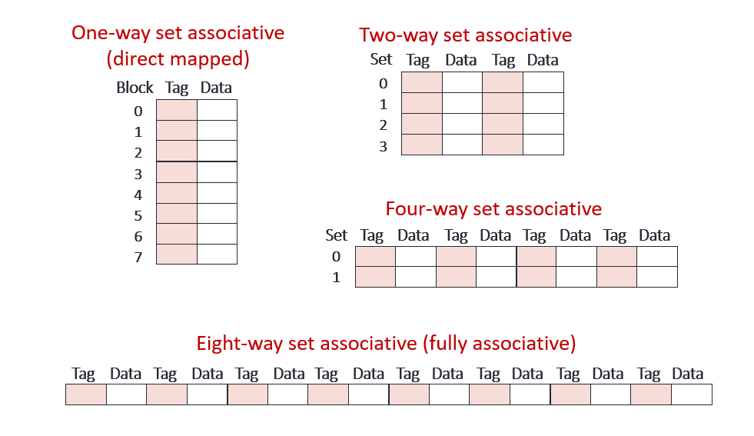
Cache Summary

Slide 50
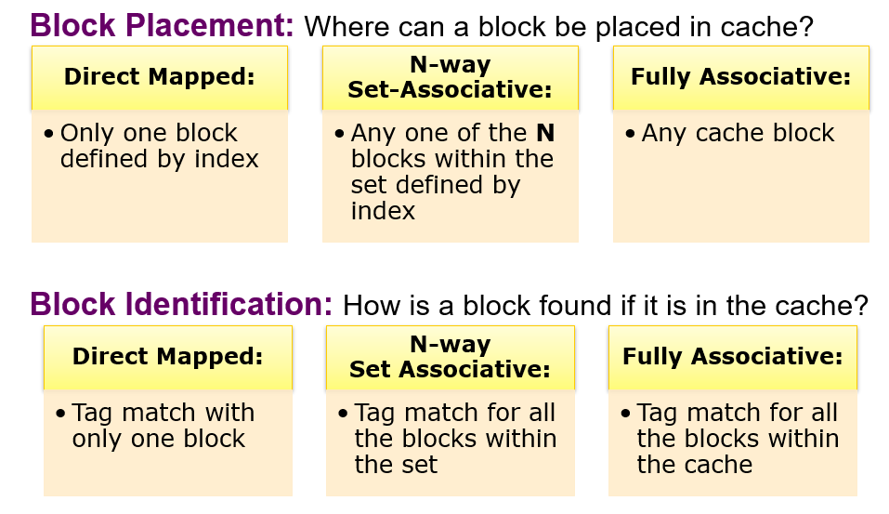
Cache Summary

Slide 51
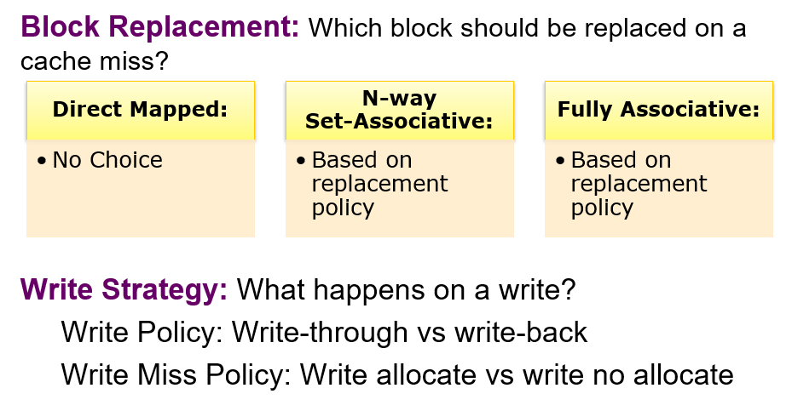
Cache Summary

Slide 52
AY2021/22 Semester 1 Exam Q16

Slide 53
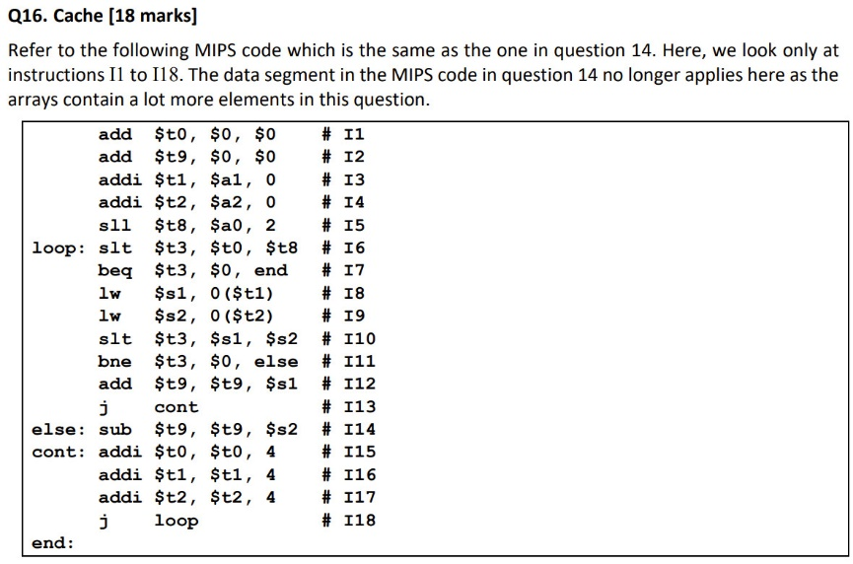
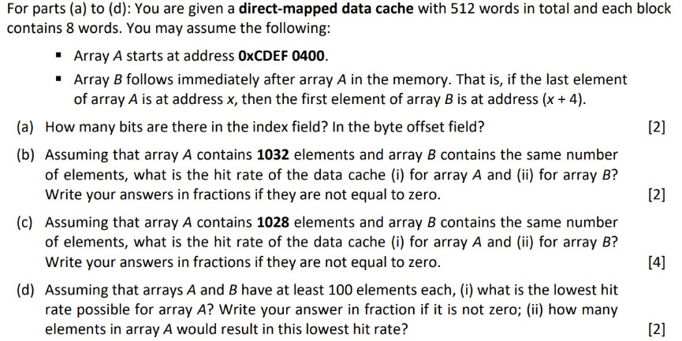
AY2021/22 Sem1 Q16

Slide 54
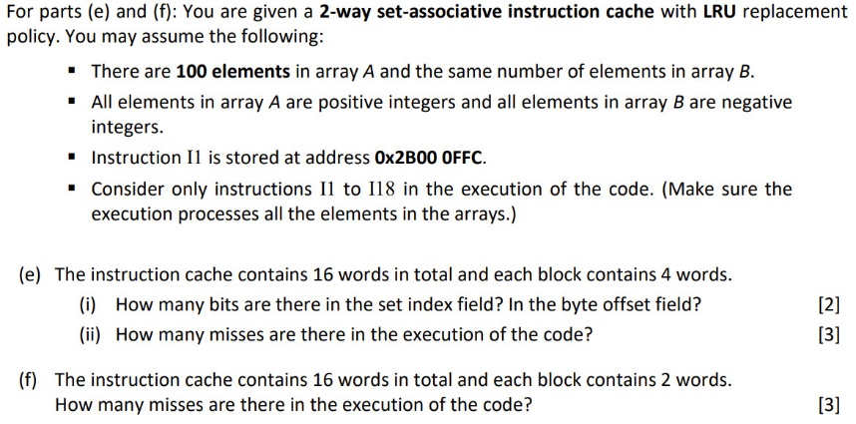
AY2021/22 Sem1 Q16

Slide 55
add $t0, $0, $0 # I1
add $t9, $0, $0 # I2
addi $t1, $a1, 0 # I3
addi $t2, $a2, 0 # I4
sll $t8, $a0, 2 # I5
loop: slt $t3, $t0, $t8 # I6
beq $t3, $0, end # I7
lw $s1, 0($t1) # I8
lw $s2, 0($t2) # I9
slt $t3, $s1, $s2 # I10
bne $t3, $0, else # I11
add $t9, $t9, $s1 # I12
j cont # I13
else: sub $t9, $t9, $s2 # I14
cont: addi $t0, $t0, 4 # I15
addi $t1, $t1, 4 # I16
addi $t2, $t2, 4 # I17
j loop # I18
end:
Direct-mapped data cache with 512 words in total and each block contains 8 words.
You may assume:
Array A starts at address 0xCDEF 0400.
Array B follows immediately after array A in the memory.
(a) How many bits are there in the index field? Byte offset field?
Number of blocks = 512/8 = 64 = 2⁶.
Therefore, index field: 6 bits.
Number of bytes in a block = 8×4 = 32 = 2⁵.
Therefore, byte offset field: 5 bits.
for (answer=0, k=0; k<size; k++) {
if (A[k]>=B[k]) answer += A[k];
else answer -= B[k];
}

Slide 56
Direct-mapped data cache with 512 words in total and each block contains 8 words.
You may assume:
Array A starts at address 0xCDEF 0400.
Array B follows immediately after array A in the memory.
Index: 6 bits
Byte offset: 5 bits
Block
32
A0 | A1 | A2 | A3 | A4 | A5 | A6 | A7
33
B0 | B1 | B2 | B3 | B4 | B5 | B6 | B7
(b) Arrays A and B each has 1032 elements. What is the hit rate for arrays A and B?
Array A start addr = 0xCDEF 0400
= 0b … 0000 0100 0000 0000.
Therefore, A[0] resides in word 0 of block 32.
A[1024] to A[1031] will occupy block 32.
Therefore, B[0] will occupy word 0 of block 33.
for (answer=0, k=0; k<size; k++) {
if (A[k]>=B[k]) answer += A[k];
else answer -= B[k];
}
No cache trashing. For every 8 elements, the first is a miss and the rest are hits.
Therefore, hit rate is 7/8 for both arrays.

Slide 57
Block
Direct-mapped data cache with 512 words in total and each block contains 8 words.
You may assume:
Array A starts at address 0xCDEF 0400.
Array B follows immediately after array A in the memory.
Index: 6 bits
Byte offset: 5 bits
32
A1024 | A1025 | A1026 | A1027 | B0 | B1 | B2 | B3
Array A start addr = 0xCDEF 0400
= 0b … 0000 0100 0000 0000.
Therefore, A[0] resides in word 0 of block 32.
(c) Arrays A and B each has 1028 elements. What is the hit rate for arrays A and B?
A[1024] to A[1027] will occupy the first 4 words of block 32, and B[0] to B[3] will occupy the next 4 words in the same block.
Therefore, for every 8 elements, the first 5 will be misses and the next 3 are hits, and this applies to the first 1024 elements. For the last 4 elements, they are all misses due to thrashing.
Hence, there are 3/8 × 1024 = 384 hits altogether for each array.
Therefore, hit rate = 384/1028.
Snapshot of first 16 elements:
Block 32 | A0 (M) | A1 (M) | A2 (M) | A3 (M) | A4 (M) B0 (M) | A5 (H) B1 (M) | A6 (H) B2 (M) | A7 (H) B3 (M)
Block 33 | B4 (M) A8 (M) | B5 (H) A9 (M) | B6 (H) A10 (M) | B7 (H) A11 (M) | B8 (M) A12 (M) | B9 (M) A13 (H) | B10 (M) A14 (H) | B11 (M) A15 (H)
Block 34 | B12 (M) | B13 (H) | B14 (H) | B15 (H)

Slide 58
Direct-mapped data cache with 512 words in total and each block contains 8 words.
You may assume:
Array A starts at address 0xCDEF 0400.
Array B follows immediately after array A in the memory.
Index: 6 bits
Byte offset: 5 bits
(d) Assuming that arrays A and B have at least 100 elements each, (i) what is the lowest hit rate possible for array A? (ii) how many elements in array A would result in this lowest hit rate?
(i) Lowest hit rate is 0. This occurs when there is cache trashing, i.e. the first elements of array A and array B are mapped to the same cache location.
(ii) When array A has a multiple of 512 elements (this is the simplest answer).

Slide 59
add $t0, $0, $0 # I1
add $t9, $0, $0 # I2
addi $t1, $a1, 0 # I3
addi $t2, $a2, 0 # I4
sll $t8, $a0, 2 # I5
loop: slt $t3, $t0, $t8 # I6
beq $t3, $0, end # I7
lw $s1, 0($t1) # I8
lw $s2, 0($t2) # I9
slt $t3, $s1, $s2 # I10
bne $t3, $0, else # I11
add $t9, $t9, $s1 # I12
j cont # I13
else: sub $t9, $t9, $s2 # I14
cont: addi $t0, $t0, 4 # I15
addi $t1, $t1, 4 # I16
addi $t2, $t2, 4 # I17
j loop # I18
end:
2-way set associative instruction cache with LRU replacement policy. You may assume:
Array A and array B each contains 100 elements.
Array A contains +ve values, array B contains -ve values.
Instruction I1 is stored at address 0x2B00 0FFC.
(e) The instruction cache contains 16 words in total and each block contains 4 words.
(i) How many bits in the set index field? In the byte offset field?
Number of sets = 16/4/2 = 2 = 2¹.
Therefore, set index field: 1 bit.
for (answer=0, k=0; k<size; k++) {
if (A[k]>=B[k]) answer += A[k];
else answer -= B[k];
}
Number of bytes in a block = 4×4 = 16 = 2⁴.
Therefore, byte offset field: 4 bits.

Slide 60
add $t0, $0, $0 # I1
add $t9, $0, $0 # I2
addi $t1, $a1, 0 # I3
addi $t2, $a2, 0 # I4
sll $t8, $a0, 2 # I5
loop: slt $t3, $t0, $t8 # I6
beq $t3, $0, end # I7
lw $s1, 0($t1) # I8
lw $s2, 0($t2) # I9
slt $t3, $s1, $s2 # I10
bne $t3, $0, else # I11
add $t9, $t9, $s1 # I12
j cont # I13
else: sub $t9, $t9, $s2 # I14
cont: addi $t0, $t0, 4 # I15
addi $t1, $t1, 4 # I16
addi $t2, $t2, 4 # I17
j loop # I18
end:
2-way set associative instruction cache with LRU replacement policy. You may assume:
Array A and array B each contains 100 elements.
Array A contains +ve values, array B contains -ve values.
Instruction I1 is stored at address 0x2B00 0FFC.
(e) The instruction cache contains 16 words in total and each block contains 4 words.
(ii) How many misses are there?
Addr of I1 = 0x2B00 0FFC = 0b… 1111 1100.
So I1 is stored in set 1, word 3.
1st iteration: I1 – I13, I15 – I18;
2nd – 100th: I6 – I13, I15 – I18; winding up: I6 and I7.
I2 (M) I18 (M) | I3 (H) | I4 (H) | I5 (H) | I10 (M) | I11 (H) | I12 (H) | I13 (H)
 | I15 (M) | I16 (H) | I1 (M) I17 (H) | I6 (M) | I7 (H) | I8 (H) | I9 (H)
6 misses in 1st iteration, thereafter all hits.
Set 0
Set 1

Slide 61
2-way set associative instruction cache with LRU replacement policy. You may assume:
Array A and array B each contains 100 elements.
Array A contains +ve values, array B contains -ve values.
Instruction I1 is stored at address 0x2B00 0FFC.
(f) The instruction cache contains 16 words in total and each block contains 2 words. How many misses are there?
I2 (M) I18 (M) | I3 (H) | I10 (M) | I11 (H)
I4 (M) | I5 (H) | I12 (M) | I13 (H)
I6 (M) | I7 (H) |  | I15 (M)
I16 (M) | I1 (M) I17 (H) | I8 (M) | I9 (H)
Set 0
Set index: 2 bits
Byte offset: 3 bits
Set 1
Set 2
Addr of I1 = 0x2B00 0FFC = 0b… 1111 1100.
So I1 is stored in set 3, word 1.
Set 3
1st iteration: I1 – I13, I15 – I18;
2nd – 100th: I6 – I13, I15 – I18; winding up: I6 and I7.
10 misses in 1st iteration, thereafter all hits.

Slide 62
CACHE QUIZ

Slide 63
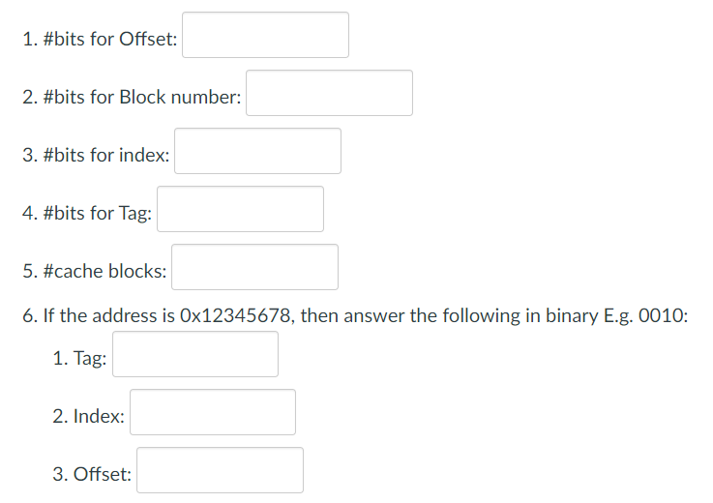
Cache Quiz Question 1
For a memory with size 4GB, each block is 32 bytes. The size of the cache is 32KB with the same block size. Fill in the following with respect to Direct Mapping Cache:
log₂(32) = 5
How many bytes per block? 32 = 2⁵
Memory size = 4GB = 2³² bytes. Hence address has 32 bits, out of which 5 bits are used for offset.
32 – 5 = 27
10
How many blocks in cache? 32KB/32 = (32×2¹⁰)/32 = 2¹⁰
32 – 10 – 5 = 17
Tag size = address size – index size – byte offset size
1024
2¹⁰ = 1024
0b00010010001101000
0x12345678
= 0b 0001 0010 0011 0100 0101 0110 0111 1000
0b1010110011
0b11000

Slide 64
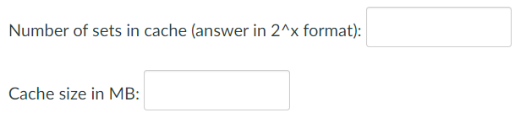
Cache Quiz Question 2
Consider a 4-way set associative mapped cache with block size 4KB. The size of the main memory is 16GB and there are 10 bits in the tag. Find the number of sets in the cache and the size of the cache.
2¹²
64
Memory size = 16GB = 2³⁴ bytes. Hence address has 34 bits.
Size of one block = 4KB = 2¹² bytes. Therefore, byte offsets = 12 bits.
No. of set index bits = address size – tag size – byte offset size
= 34 – 10 – 12 = 12.
Therefore, number of sets = 2¹².
Size of each cache set = 4 × block size = 4 × 4KB = 16KB = 2¹⁴ bytes.
Therefore, cache size = 2¹² × 2¹⁴ bytes = 2²⁶ bytes = 2⁶ MB = 64MB.

Slide 65
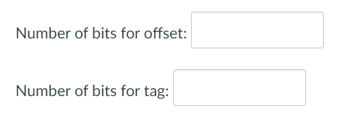
Cache Quiz Question 3
Given a fully set associative cache. The size of the main memory is 256MB, size of cache memory is 16KB and the block size is 256bytes. Find the number of bit for byte offset and tag.
8
28 – 8 = 20
Memory size = 256MB = 2²⁸ bytes. Hence address has 28 bits.
Block size = 256 bytes = 2⁸ bytes.

Slide 66
FINAL EXAM

Slide 67
Final Exam (AY2024/25 semester 2)
3 May 2025, Saturday, 9 – 11am
MPSH6
Earlier topics (≈30%)
Later topics (≈70%)
Format:
18 MCQs (36 marks)
5 multi-parts questions (64 marks)

Slide 68
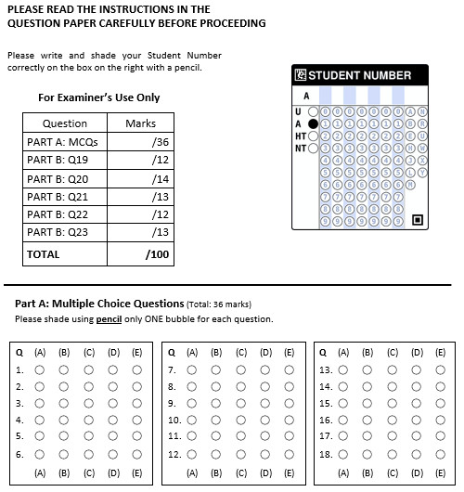
Final Exam (AY2024/25 semester 2)
Bring your pencils (2B or above), eraser, writing papers.
Shade your Student Number correctly (and check!) using pencil.
Shade the MCQ answers using pencil.
Do NOT write your answers outside the boxes provided.

Slide 69
End of File

